Slide 1
Chapter 10 Coordination in a Supply Chain
Supply Chain Management

Slide 2
Lack of SC Coordination and the Bullwhip Effect
Supply chain coordination – all stages in the supply chain take actions together (usually results in greater total supply chain profits)
SC coordination requires that each stage take into account the effects of its actions on the other stages
Lack of coordination results when:
Objectives of different stages conflict or
Information moving between stages is distorted

Slide 3
Bullwhip Effect
Fluctuations in orders increase as they move up the supply chain from retailers to wholesalers to manufacturers to suppliers (shown in Figure 10.1)
Distorts demand information within the supply chain, where different stages have very different estimates of what demand looks like
Results in a loss of supply chain coordination

Slide 4
Demand at Different Stages
Figure 10-1

Slide 5
Bullwhip Effect in Supply Chains
Forrestor: Industrial Dynamics, Harvard Business Review, 36:4, 1958
First research paper to illustrate systems dynamics in SCN's
Base for developing Distribution Games
"BWE" coined by Proctor & Gamble
BWE describes the increasing amplification of orders occurring within a Supply Chain
Resembles a whip lash
Occurs even if end-item demand is fairly stable!
Forrestor studied a simulation model of the simplest tandem supply chain with four entities: Retailer, DC, W/H, Plant

Slide 6
Bullwhip Effect
Assumptions of Forrestor's model:
Each entity can make use of only locally available info
Time delays between ordering and receipt of order
It takes 3 weeks for retailer to process the order, half a week to transmit it to DC
The DC takes 1 week to process the order and one week to ship to the retailer, who takes one week to ship to end customer; assumptions for other entities likewise..
To study impact of a one time +10% change in retail sales on orders placed and inventory levels

Slide 7
Bullwhip Effect
Forrestor's results:
"...A sudden 10% increase in retail sales implies a peaking of 34% on orders @ 14th week in factory w/h, resulting in factory output peaking in 21st week (including a 6 week lead time) by a whopping 45%.."
Amplified and out of phase fluctuations in ordering and inventory levels
Avoidable inventory and shortage costs; Unstable system
RELEVANT EVEN TODAY!
Replace week by day in the above analysis

Slide 8
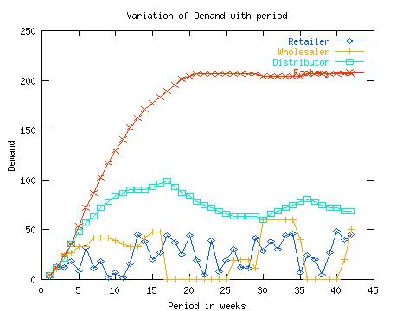
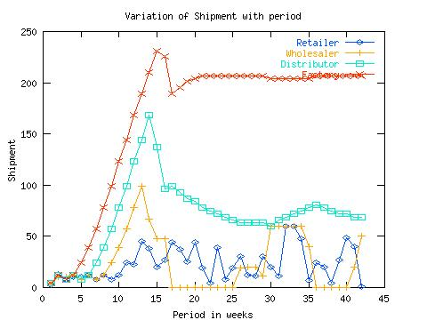
Bullwhip Effect: Some Illustrations

Slide 9
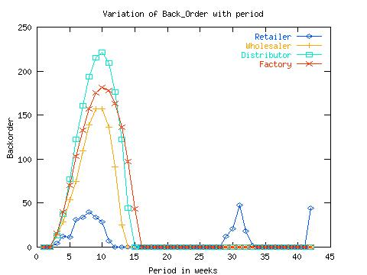
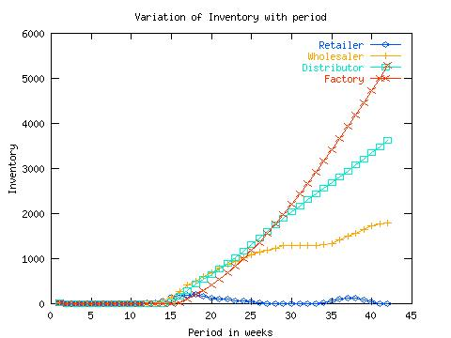
Bullwhip Effect: Some Illustrations

Slide 10
Bullwhip Effect
Causes of BWE: (Empirical: Lee et al: 1997; Analytical: Chen et al: 2000)
Demand Signal Processing (frequent updates of forecasts; only next echelon orders considered)
Order Batching (to realise logistics EoS+Reducing order processing costs)
Price Fluctuations (resulting in over-reactions)
Supply Rationing (Proportionate rationing; unrestricted order acceptance+free return policy)

Slide 11
Information Processing Obstacles
When demand information is distorted as it moves between different stages of the supply chain,
leading to increased variability in orders within the supply chain
Forecasting based on orders, not customer demand
Forecasting demand based on orders magnifies demand fluctuations moving up the supply chain from retailer to manufacturer
Lack of information sharing

Slide 12
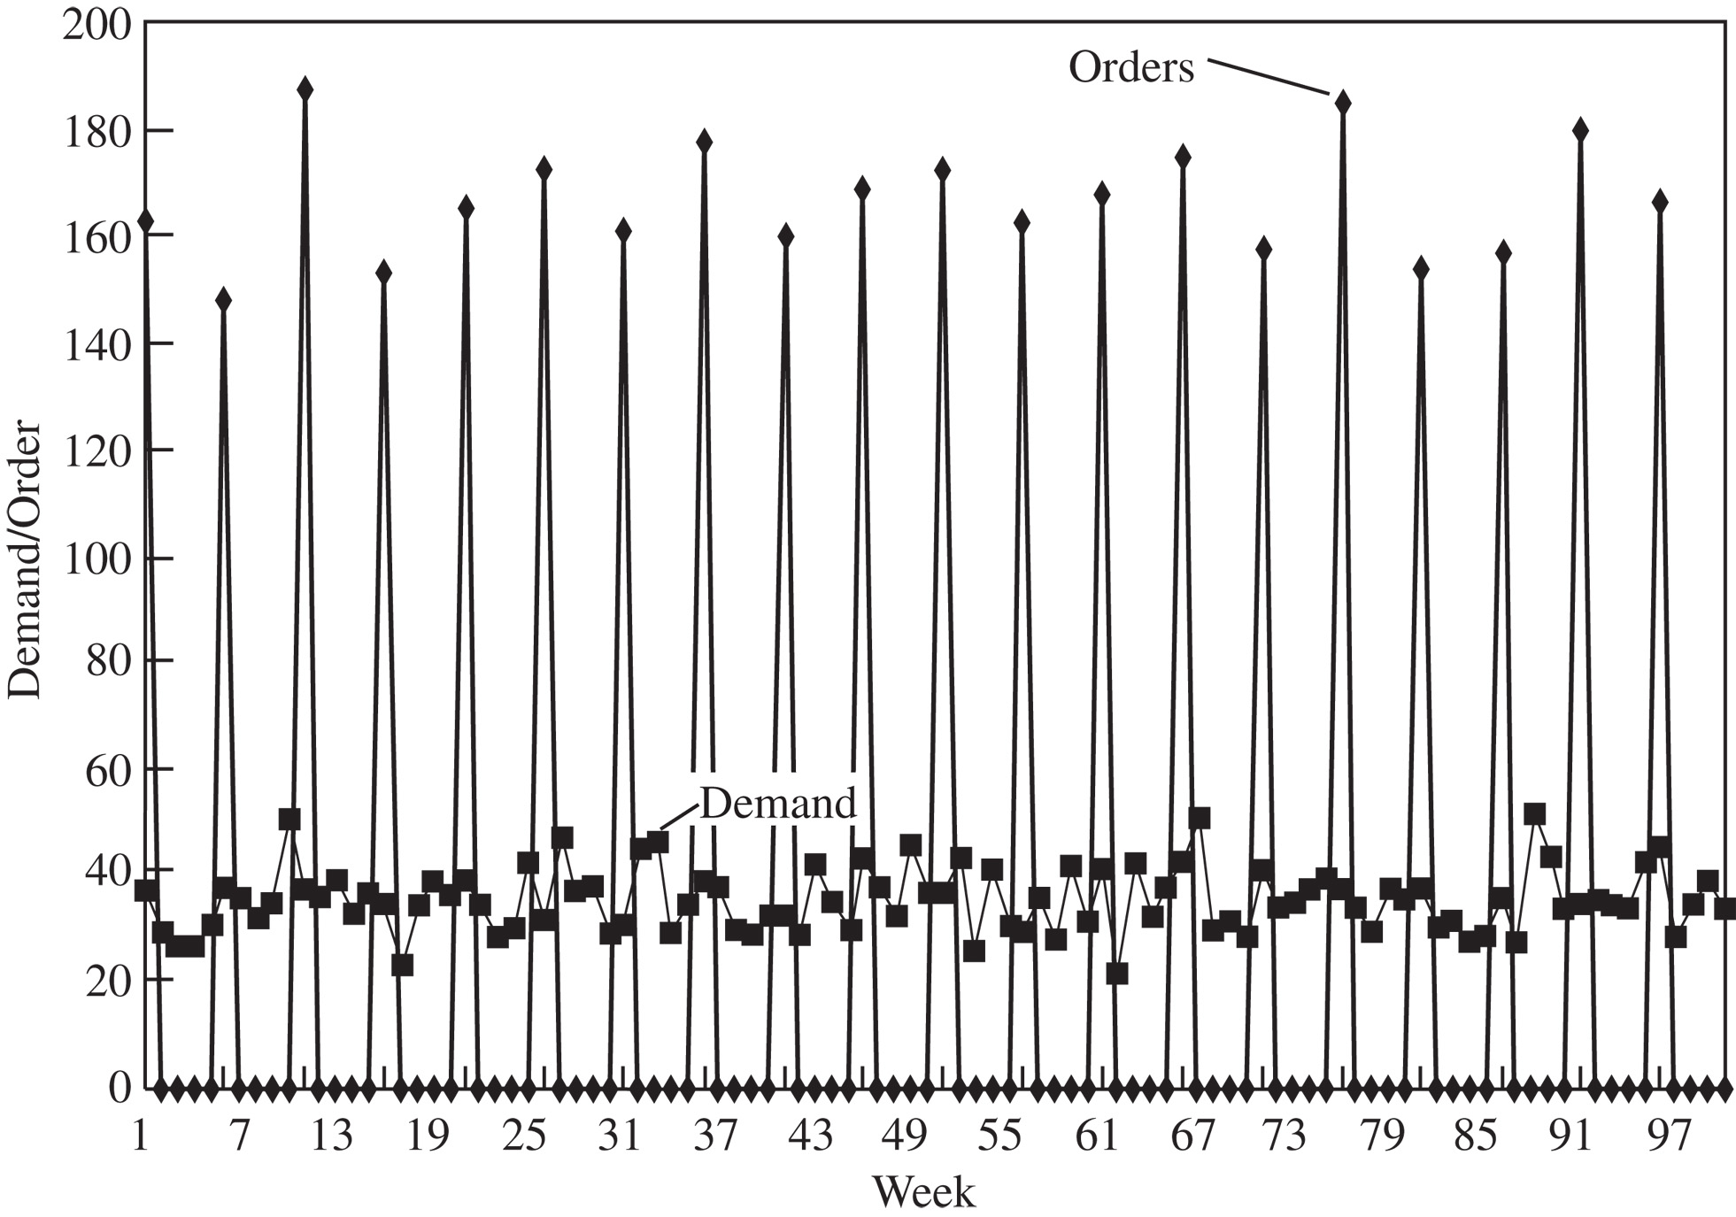
Operational Obstacles
Actions taken in the course of placing and filling orders that lead to an increase in variability
Ordering in large lots (much larger than dictated by demand) – Figure 10.2
Large replenishment lead times
Rationing and shortage gaming (common in the computer industry because of periodic cycles of component shortages and surpluses)
Figure 10-2

Slide 13
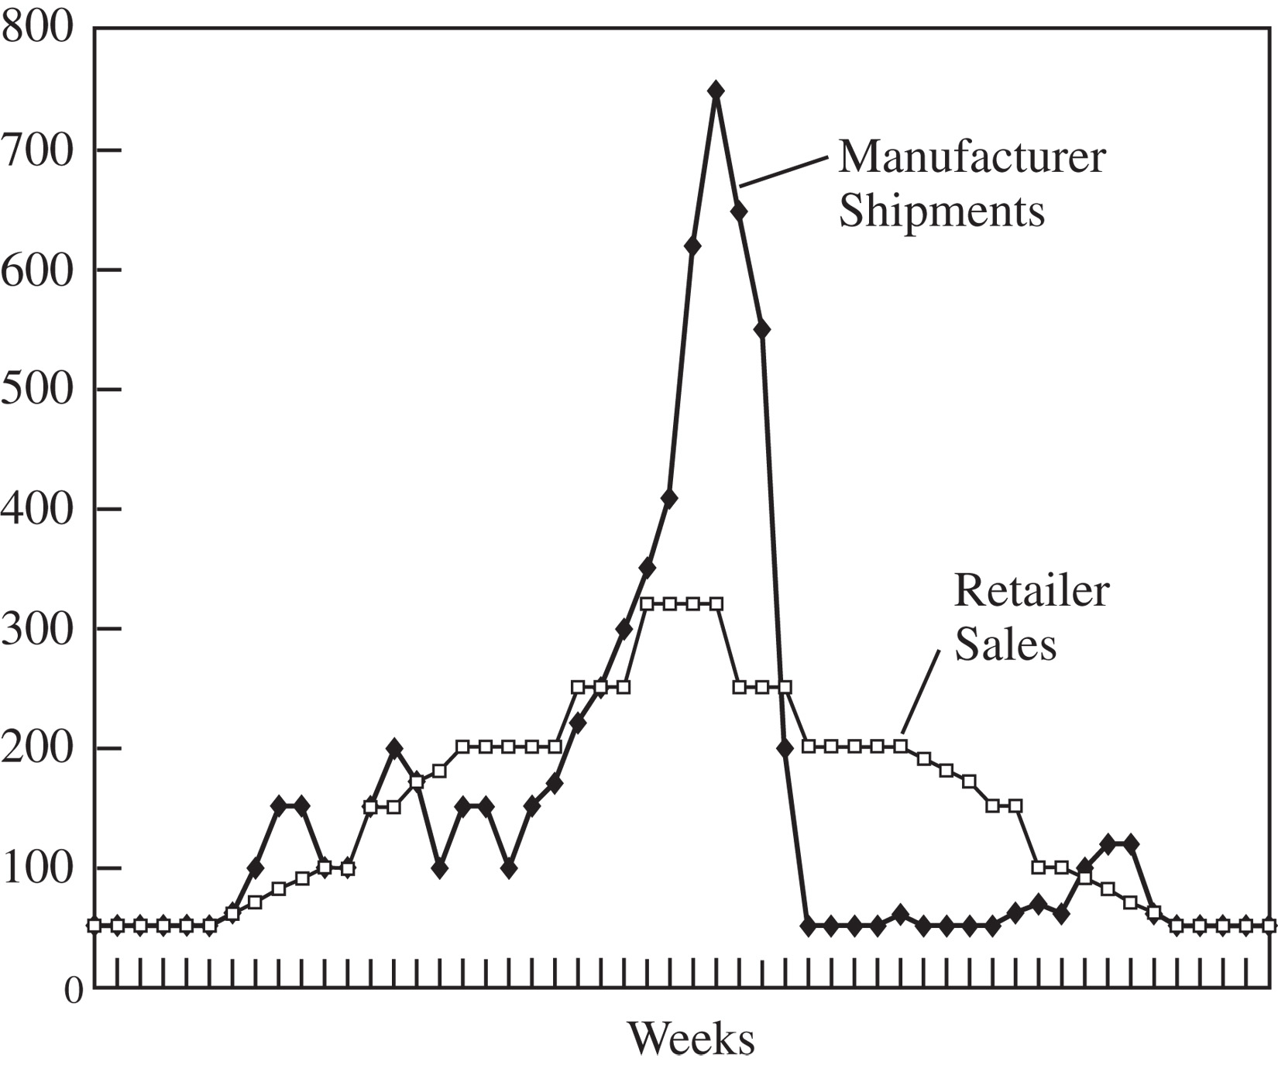
Pricing Obstacles
When pricing policies for a product lead to an increase in variability of orders placed
Lot-size based quantity decisions
Price fluctuations (resulting in forward buying) – Figure 10.3
Figure 10-3

Slide 14
The Effect on Performance
Performance Measure | Impact of the Lack of Coordination
Manufacturing cost | Increases
Inventory cost | Increases
Replenishment lead time | Increases
Transportation cost | Increases
Shipping and receiving cost | Increases
Level of product availability | Decreases
Profitability | Decreases
Table 10-1

Slide 15
Aligning Goals and Incentives
Align goals and incentives so that every participant in supply chain activities works to maximize total supply chain profits
Align goals across the supply chain
Align incentives across functions
Pricing for coordination
Alter sales force incentives from sell-in (to the retailer) to sell-through (by the retailer)
Sharing point of sale data
Collaborative forecasting and planning

Slide 16
Improving Operational Performance
Reducing replenishment lead time
Reduces uncertainty in demand
EDI is useful
Reducing lot sizes
Computer-assisted ordering, B2B exchanges
Shipping in LTL sizes by combining shipments
Technology and other methods to simplify receiving
Changing customer ordering behavior
Rationing based on past sales and sharing information to limit gaming
“Turn-and-earn”
Information sharing

Slide 17
Designing Pricing Strategies to Stabilize Orders
Encouraging retailers to order in smaller lots and reduce forward buying
Moving from lot size-based to volume-based quantity discounts (consider total purchases over a specified time period)
Stabilizing pricing
Eliminate promotions (everyday low pricing, EDLP)
Limit quantity purchased during a promotion
Tie promotion payments to sell-through rather than amount purchased
Building strategic partnerships and trust – easier to implement these approaches if there is trust

Slide 18
Vendor-Managed Inventories (VMI)
Manufacturer or supplier is responsible for all decisions regarding inventory at the retailer
Control of replenishment decisions moves to the manufacturer
Requires that the retailer share demand information with the manufacturer
Manufacturer can increase its profits and total supply chain profits by reducing effects of double marginalization
Having final customer demand data also helps manufacturer plan production more effectively
Potential drawback – when retailers sell products that are substitutes in customers’ minds

Slide 19
Collaborative Planning, Forecasting, and Replenishment (CPFR)
CPFR Scenario | Where Applied in Supply Chain | Industries Where Applied
Retail event collaboration | Highly promoted channels or categories | All industries other than those that practice EDLP
DC replenishment collaboration | Retail DC or distributor DC | Drugstores, hardware, grocery
Store replenishment collaboration | Direct store delivery or retail DC-to-store delivery | Mass merchants, club stores
Collaborative assortment planning | Apparel and seasonal goods | Department stores, specialty retail
Table 10-2

Slide 20
Trust in the Supply Chain
Historically, supply chain relationships are based on power or trust
Disadvantages of power-based relationship:
Results in one stage maximizing profits, often at the expense of other stages
Can hurt a company when balance of power changes
Less powerful stages have sought ways to resist
Deterrence-based view
Use formal contracts
Parties behave in trusting manner out of self-interest
Process-based view
Trust and cooperation are built up over time as a result of a series of interactions
Positive interactions strengthen the belief in cooperation of other party
Neither view holds exclusively in all situations

Slide 21
Designing a Relationship with Cooperation and Trust
Assessing the value of the relationship and its contributions
Identifying operational roles and decision rights for each party
Designing effective conflict resolution mechanisms
Assessing the Value of the Relationship and its Contributions
Identify the mutual benefit provided
Identify the criteria used to evaluate the relationship (equity is important)
Important to share benefits equitably
Clarify contribution of each party and the benefits each party will receive

Slide 22
Creating Effective Contracts
Create contracts that encourage negotiation when unplanned contingencies arise
It is impossible to define and plan for every possible occurrence
Informal relationships and agreements can fill in the “gaps” in contracts
Informal arrangements may eventually be formalized in later contracts
Perceptions of reduced benefits or opportunistic actions can significantly impair a supply chain partnership

Slide 23
Incentive Obstacles
When incentives offered to different stages or participants in a supply chain lead to actions that increase variability and reduce total supply chain profits
misalignment of total supply chain objectives and individual objectives
Local optimization within functions or stages of a supply chain
Sales force incentives

Slide 24
Behavioral Obstacles
Problems in learning, often related to communication in the supply chain and how the supply chain is structured
Each stage of the supply chain views its actions locally and is unable to see the impact of its actions on other stages
Different stages react to the current local situation rather than trying to identify the root causes
Based on local analysis, different stages blame each other for the fluctuations, with successive stages becoming enemies rather than partners
No stage learns from its actions over time because the most significant consequences of the actions of any one stage occur elsewhere, resulting in a vicious cycle of actions and blame
Lack of trust results in opportunism, duplication of effort, and lack of information sharing

Slide 25
The beer game
http://www.beergame.org/
Chapter 10 Coordination in a Supply Chain

Slide 26
Structure & Rules
How is it played?
The beer game simulates a four stage supply chain (retailer, wholesaler, distributer and factory). Each stage is played by one or better two or three players.
A supply chain is typically played by 8 to 12 people; more than one supply chain can be administered in one class at the same time.
Delay
Factory
Delay
Distributor
Delay
Wholesaler
Delay
Retailer

Slide 27
Structure & Rules
The task
The task of each supply chain is to produce and deliver
units of beer:
the factory produces and the other three stages deliver the beer units until it reaches the external customer at the downstream end of the supply chain.
The aim of the players is rather simple:
each sub group has to fulfil the incoming orders of beer.

Slide 28
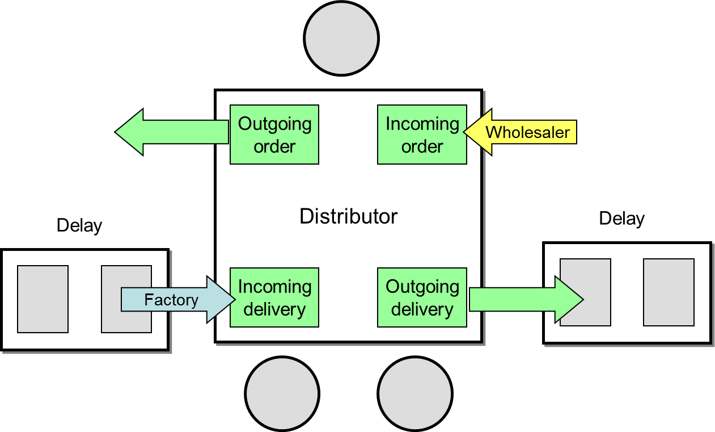
Structure & Rules
Structural setup
Orders flow upstream, while deliveries flow downstream
in the supply chain.
An important structural aspect is delay (i.e. time lag) in
order to account for logistics and production time. Each
delivery (and production order) requires two rounds until
they are finally delivered to the next stage.
In the structural setup this is represented by two
shipping delay fields located in between the supply chain
stages as well as at the production end.

Slide 29
Structure & Rules
Playing the game
The game is played in rounds, which simulates weeks.
Using the materials provided on the table (see figure 2),
players have to carry out the following steps in each
round:
1. receive incoming orders
2. receive incoming deliveries
3. update play sheets (outstanding deliveries and
inventory)
4. send out deliveries, and finally
5. decide on the amount to be ordered
Deciding on each round’s order amount is effectively the
only decision that players are able to make throughout
the game.

Slide 30
Structure & Rules
Essential rules
Every order has to be fulfilled, either directly (should the
players’ inventory be large enough) or later in subsequent rounds.
Inventory and backlog incur cost – each item in stock costs EUR 0.50 per week, while each item on backlog costs EUR 1.00. Consequently, the primary aim of each subgroup is to keep their costs low.
Hence, the optimal strategy for the players is to run their
business with as little stock as possible without being
forced to “move into backorder”.
Players are not allowed to communicate. The only information they are allowed to exchange is the order amount; there is no transparency as to what stock levels or actual customer demand is; only the retailer knows the external demand .

Slide 31
Structure & Rules
Customer demand
The external demand is predetermined and usually does
not vary greatly.
In the beginning, the supply chain is pre-initialized with
inventory levels (e.g. 15 units), orders (e.g. 5 units) and
beer units in the shipping delay fields (e.g. 5 units).
In order to induce the bullwhip effect, the external
demand remains stable for a few rounds (e.g. 5 units for
5 rounds) before it suddenly shows one steep increase
(jumps to 9 units) before it remains stable again at this
higher level for the remainder of the game (usually 40
to 50 rounds in total).
The one increase in external demand inevitably leads to
the creation of the bullwhip effect and to a destabilization of ordering patterns throughout the supply chain.

Slide 32
The beer game
Delay
Factory
Delay
Distributor
Delay
Wholesaler
Delay
Retailer

Slide 33
Step 1: Delivery IN
Delay
Factory
Delay
Distributor
Delay
Wholesaler
Delay
Retailer
Fill in incoming delivery to your playsheet.
Add incoming to inventory to get available amount.

Slide 34
Step 2: Order IN
Delay
Factory
Delay
Distributor
Delay
Wholesaler
Delay
Retailer
Open new order and fill into your playsheet.
Calculate amount to ship by adding new order to old backorder.

Slide 35
Step 3: Prepare Delivery
Delay
Factory
Delay
Distributor
Delay
Wholesaler
Delay
Retailer
DELIVERY
9

Slide 36
Step 3: Prepare Delivery
Delay
Factory
Delay
Distributor
Delay
Wholesaler
Delay
Retailer
Figure out whether the amount to ship can be fulfilled from available stock.
If yes, then your delivery equals the amount to ship.
If not, you ship whatever is available, the rest adds to backorder.
Update your backorder!

Slide 37
Step 4: Place your order
Delay
Factory
Delay
Distributor
Delay
Wholesaler
Delay
Retailer
ORDER
12
That is entirely your decision.
Keep your cost low!

Slide 38
Between weeks: logistics!
Delay
Factory
Delay
Distributor
Delay
Wholesaler
Delay
Retailer

Slide 39
The beer game
Delay
Factory
Delay
Distributor
Delay
Wholesaler
Delay
Retailer

Slide 40
Total Cost
Team # | Game # | Total Cost | Factory Cost | Distributor Cost | Wholesaler Cost | Retailer Cost
3 | Game 1 | 8827 | 2963.5 | 4329.5 | 634 | 900
4 | Game 1 | 2985 | 559.5 | 933 | 812 | 680.5
5 | Game 1 | 7672 | 3378 | 2965.5 | 800 | 528.5
8 | Game 1 | 5503 | 159.5 | 1049 | 3292.5 | 1002
9 | Game 1 | 3075.5 | 522 | 818.5 | 895 | 840
Team # | Game # | Total Cost | Factory Cost | Distributor Cost | Wholesaler Cost | Retailer Cost
4 | Game 2 | 1317.5 | 387.5 | 585 | 207 | 138
9 | Game 2 | 2937.5 | 541.5 | 1458 | 680 | 258

Slide 41
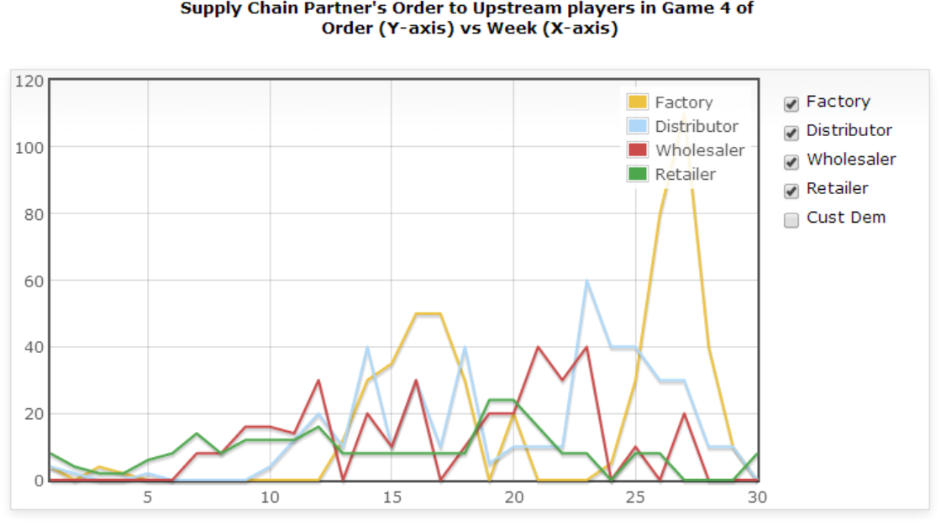
Champion Team Order Plot

Slide 42
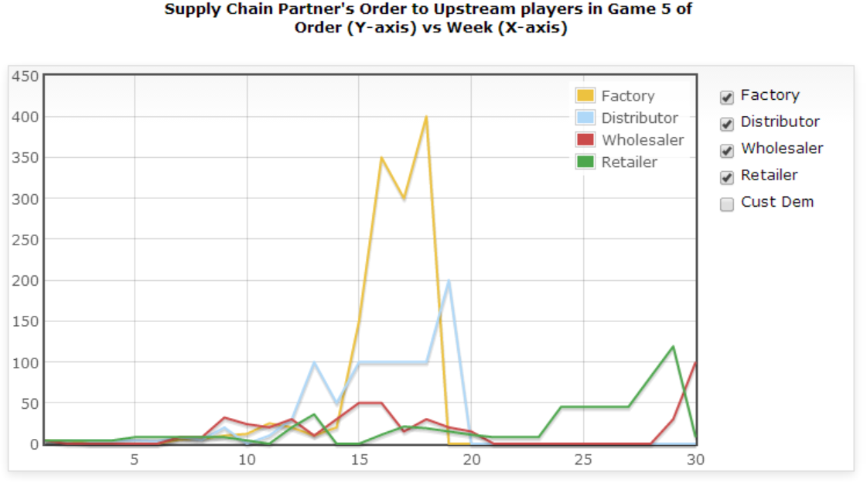
Lowest Cost Retailer Team Order Plot

Slide 43
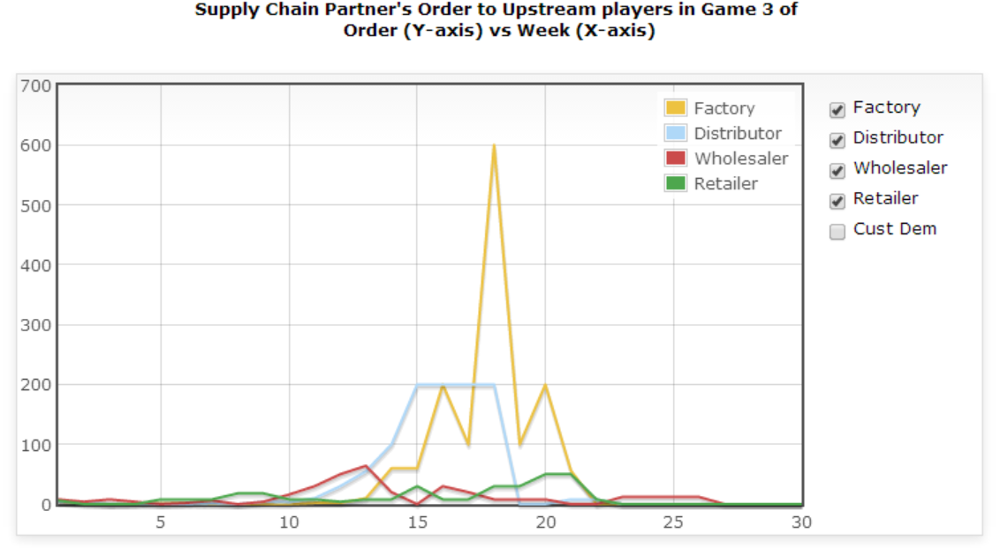
Lowest Cost Wholesaler Team Order Plot

Slide 44
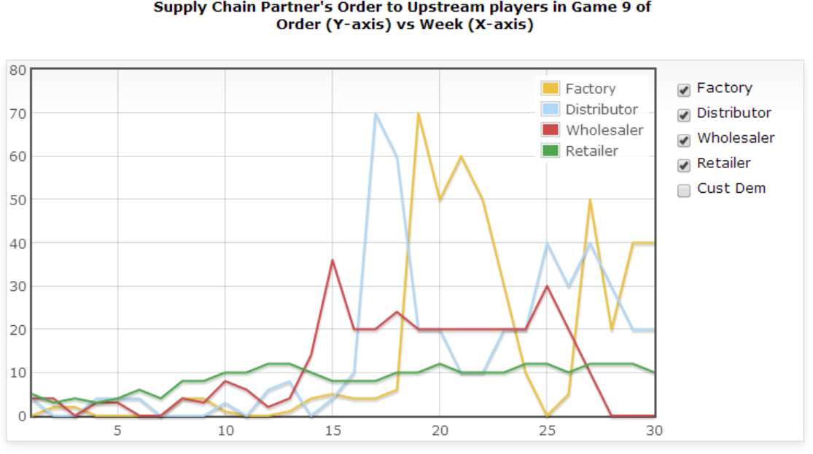
Lowest Cost Distributor Team Order Plot

Slide 45
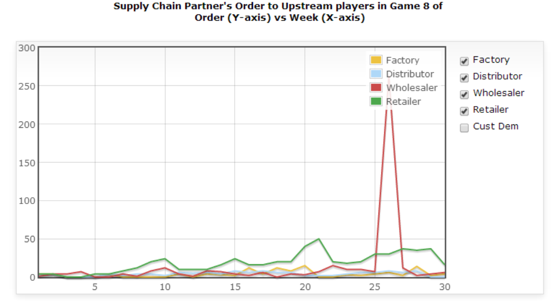
Lowest Cost Factory Team Order Plot

Slide 46
Obstacles
Incentive Obstacles
The goal: keep the lowest total cost of a team.
But each stage’s forecasting and planning are kept to themselves.
People would still seek out a local optimization.
Information Processing Obstacles
Independent forecasting at each stage based on received orders.

